Slide 1
QISS PEP Talks
Parent Education Program
Tuesday, December 13, 2016
TOPIC: Literacy Tank at QISS and Avoiding the Holiday Slide

Slide 2
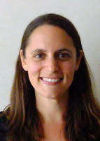
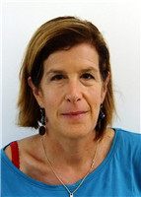
QISS PEP Talks
Presenters:
Dr. Teston
QISS Director
Mr. Matthews
School Development Coordinator
Ms. Aricia
ELL Coordinator
Ms. Kris
US ELL Specialist
Ms. Julie
ELL Specialist

Slide 3
Topics 1. Overview of QISS Literacy Tank 2. How we support students 3. How to support students at home 4. How to avoid “The Holiday Slide”
QISS PEP Talks

Slide 4
What is Literacy Tank? Overview of the Program
Lower School
Upper School
Learning Resource Center (LRC)

Slide 5
The Literacy Tank’s mission is to develop independent, motivated, and confident students who will experience improved literacy and English skills which will enrich learning in all content areas.

Slide 6
Lower School Literacy Tank
Literacy Tank class is during each grade’s literacy block.
I meet with the groups for 40 minutes everyday.
Students are grouped according to grade level, reading level, and English proficiency.
Groups are limited to 6 students.

Slide 7
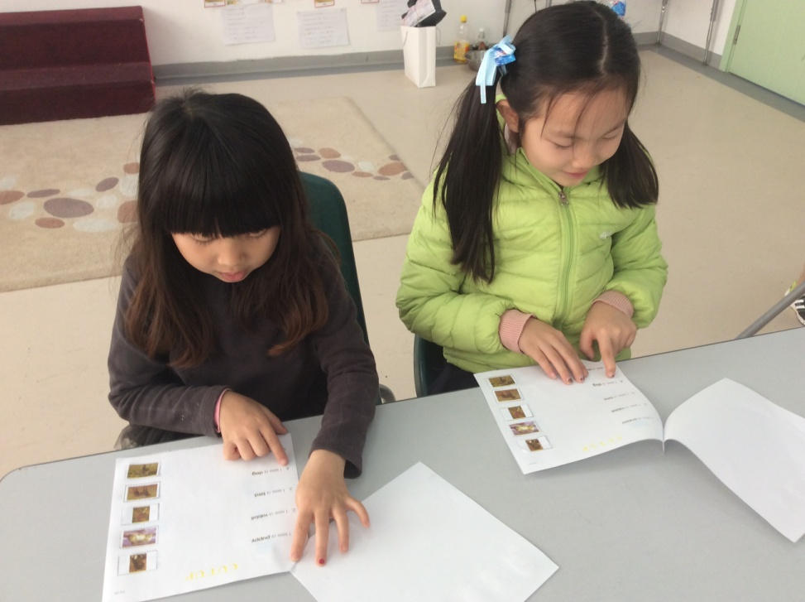
Reading

Slide 8
Writing

Slide 9
Vocabulary Development

Slide 10
Speaking

Slide 11
Reading and Working Together

Slide 12
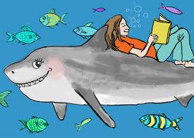
Upper School Literacy Tank
Grades 6-8 receive 200 minutes of literacy support weekly
Grades 9-12 receive 120-200 minutes of literacy support weekly
Students are grouped according to grade level, but instruction is individualized for each student
Groups are limited to 6 students.

Slide 13
My child can speak English. Why do they need literacy support?

Slide 14
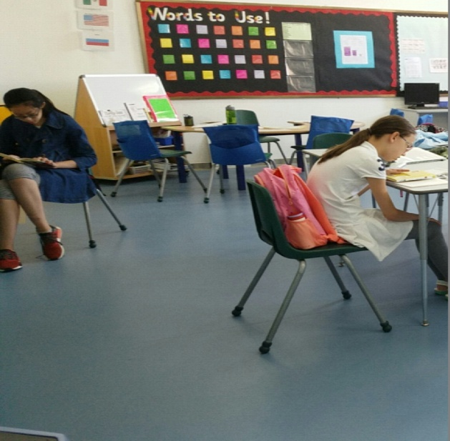
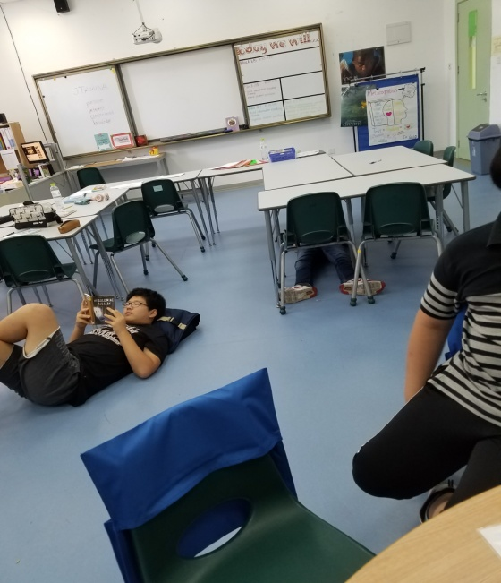
What do the students do during class?
In small group teacher guided lessons, students:

Slide 15
How to support your children at home?

Slide 16
What can parents do to support English development?

Slide 17
1. Develop a reading culture

Slide 18
2. Learn English together

Slide 19
4. Hire a tutor if necessary

Slide 20
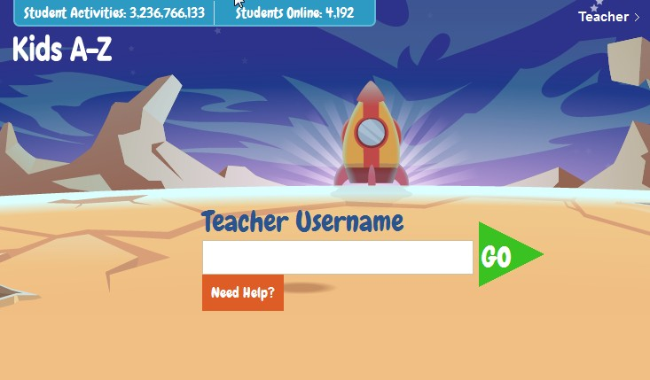
5. Read every day
www.kidsa-z.com

Slide 21
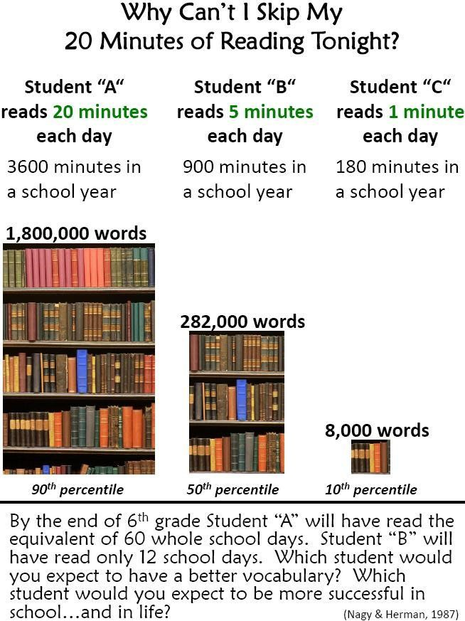

Slide 22
6. Communicate with your children’s teachers

Slide 23
Literacy Tank Commitment
To help students reach grade level proficiency in both reading and speaking English.

Slide 24
Holiday Homework

Slide 25
Teacher Tips
Clean out and organize the backpack.
Look at your holiday schedule. Plan what days your student will complete the homework. Write it down!
Ask your US student open their online grade account, Focus, and have them show you their grades.
Talk with your child about missing assignments.

Slide 26
Improve Academic Skills

Slide 27
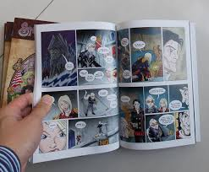
Expect Your Child to READ
Help your child to make time to read each day!
Read What?
Anything! As long as the book is one they can understand and is of interest to them.
How long?
20-30 minutes each day

Slide 28
Ideas for Lower School Children
Have your child write in journal each day.
Read to your child each day
Read with your child.
Talk about and show your children the math skills you use each day.
Require your child to speak English as often as possible

Slide 29
Ideas for Upper School Students
Make up missing assignments
Discuss current events with your child
Provide your child with reading materials in both
their native language and English
Schedule a special activity to do with your child.
Preteens and teenagers are more likely to open
up and talk to parents during times like these.

Slide 30
Give your children time to relax and have fun!

Slide 31
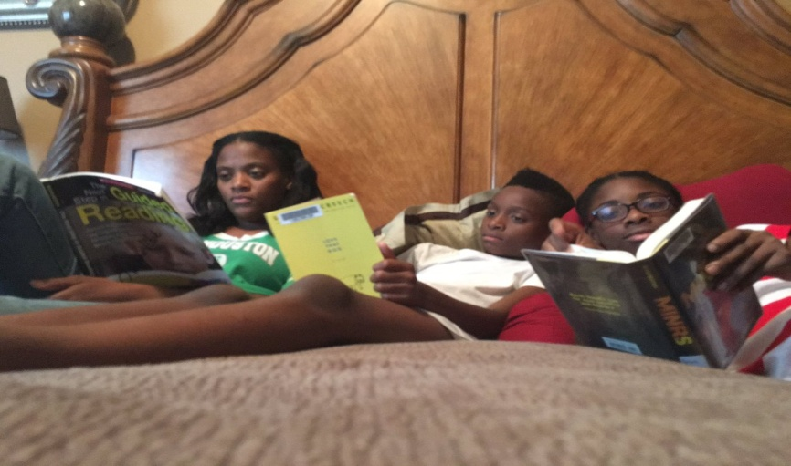
Thank you for working with us to help develop your child’s English language and reading skills!

